Slide 1
Virtualization of museums, using VR technologies
Virtualization
of museums, using VR technologies
Omarova Naila
Omarova Naila
Notes:
Azerbaijan is home to a variety of creative phenomena. A huge number of the greatest people were born and raised here and left behind no fewer great works, be it paintings, books with stories, or poems.
Most of the works of these great minds are kept in museums, which I would highly recommend to anyone who is at least a little enlightened in creativity. Every trip to the museum feels like an inspiration to create and a desire to leave behind the same colorful and beautiful light as these people did.
But thinking about it, not everyone can feel this breathtaking aura due to the fact that they live very far away and a trip to the museum is simply impossible, and some people, due to illnesses can't leave the territory of their home.
But the good thing is that technology does not stand still. Every day new inventions appear or are already being improved in order to simplify our lives. As an example, virtual reality can be fully attributed to such technologies. At the moment, virtual and augmented reality technologies are only gaining popularity and, despite this, are widely used in many areas. With this work I desire to give people the opportunity, to feel part of this magical aura that hovers there even by sitting in their own territory, in their comfort zone. Perhaps this will give someone an incentive to go further and do great things.

Slide 2



What are AR and VR
How to create virtual museum
Virtual Reality

Slide 3

CHAPTER 1
CHAPTER 1
Augmented Reality
Advantages:
1. Enhanced Experience
2. Easy to use
3. Good for enterprises
4. Is going to be improved
Disadvantages:
1. Expensive
2. Not secure
3. Health problems
4. Smartphone fever
Virtual Reality
Advantages:
1. Good for companies
2. Good experience
3. Social networking
4. Cure mental illnesses
Disadvantages:
1. Expensive
2.Communication
3. Loss of contact with real world
4. Health problems, injuries
5.Addiction
Notes:
First let me start with Augmented reality also known as AR, as its name implies, complements the world we live in by adding other virtual elements to it. Usually for this purpose, we can use our smartphone, tablets and their camera.
AR has advantages that could make it the best tool for lots of industries in the future:
Augmented Reality can offer an enhanced experience. It means that person that uses AR can hold their phone in front of an area so the app can add new details on top of their phone shows.
For people who use AR on their phone, this technology is really handy. All you need to do is show the object you would like to change with AR to the camera and the program will do everything for you.
According to the idea, AR should change the business so that customers can get more benefits so they will most likely invest. Augmented reality can help in building projects. AR lets workers identify and solve problems in the construction of objects. People can also use AR to design processes.
It is well known that AR is widely used in healthcare for education or to guide surgeons. Also, it must be noted according to recent research Augmented reality might help with dyslexia, ADHD, and other similar illnesses in a more fun way to make it easier to cure.
Actually, Augmented reality technology requires lots of hard work and practice to be felt as easy-to-use technology and organic in use. Most of the restrictions of AR include money, but it has other disadvantages that I am going to list:
Might be too expensive - this type of technology could be unaffordable to make. The apps might cost from 0 dollars to 100 thousand dollars depending on complexity. Not all companies can afford to invest in this technology, so the ones that will allocate money for AR are going to get a great advantage of this technology.
There might be some problems with security and privacy - This problem is expectable because of Augmented Realities functions. Technology makes it harder to understand where is the real world and where is augmented reality so it makes it easier to be the victim of attacks.
AR might cause health problems - Most specialists in this field, complain about problems with health that Augmented reality can cause to a person using it. most of these problems would happen because of devices used for this technology. Users of additional reality might experience loss of hearing, their eyes could be damaged, and even there might be noticeable changes in customer behavior.
AR can be very addictive - playing games is a very addictive process by itself, but when these games include AR technologies in them, most gamers won't put their devices down, and will be looking for updates throughout the day.
Virtual reality is simply a virtual 3D world. In this world users can interact environment and explore it. This technology might require some devices for users to wear and only after, it will give clients a whole experience of full immerse. But this technology is completely new it surely has some benefits and drawbacks.
Because Virtual realities have great features, different companies in different fields take advantages of this technology. VR is widely used in the military industry, in healthcare, and even in the educational field. A good example of it might be how architects use Virtual reality to see the final product and give a better assessment of the job.
While using virtual reality technologies, users feel the way they would feel being in that exact situation in real life. That gives a great experience for players. Users get the opportunity to hear sounds and experience the virtual environment thus, feeling like they are in that location in real life. It is a great chance for vr users and especially for people with disabilities to experience things they can't feel in real life.
One of the main benefits of Virtual Reality is social networking. Virtual reality gives people all over the world opportunity to communicate with each other. It is even better experience in communication than other devices could offer. Thanks to this technology, people can have a feeling of seeing each other and interacting in a virtual world.
In 2005 there were opened VR hospitals for people with various mental disorders like social phobia or schizophrenia. Usage of VR technologies in psychotherapy made a huge leap in medicine and is considered a very effective way to treat diseases such as social phobia. Even if it has not yet been proved, it is believed that Virtual reality could be very helpful technology in medicine by helping such patients that have PTSD (which is stress disorder after trauma), or depression.

Slide 4

Chapter 2
Types
Virtual reality
Software
Notes:
The more widespread Virtual Reality technologies get, the more people use them. But even despite its popularity, the system is not so safe. I am going to discuss some of its disadvantages to let users know what dangers await them with this technology.
High Cost- For people that have ever been interested in using VR technologies, it is a well-known fact that they are not cheap products. due to its complexity and advantages, these devices are not available for everyone.
VR can't and should not replace real communication - In advantages of this technology, I mentioned that one of them is better communication experience. However, still, it can't replace talking in the real world. For some people, solving all problems online even though in virtual world might seem dishonest.
Because of how interesting the virtual world is, it is easy to lose interest in the real one. Also, it is easy to run from problems using these devices, because in the virtual world, u don't have those difficulties. This type of affection might lead to a feeling of self-worthlessness.
Too much usage of VR devices might lead to headaches - VR can be used only with the help of special devices. Because of those headsets, your eyes are more focused and need to work harder that could make your head hurt. One more problem with health that could be led by VR is nausea - in virtual world environment can be a little too "active". Because our brain can confuse where the real world and where is the virtual one it can bring to nausea. One of the health problems that could happen because of VR is seizures - Overly active graphics, sudden sounds or flash lights might lead to twitching in eyes or muscles, or to diseases I listed above. VR also might cause injuries - While using VR devices users don't see the environment. For example, if user plays a game at home, using VR headsets, they can trip and fall because they cannot see their feet and the environment. That is dangerous for players because it might cause several body injuries.
VR might be very addictive - According to its popularity, it is not hard to guess one of the main disadvantages of Virtual Reality. This type of technology, due to its features, can make users addicted. As a result, users might lose interest In the real world and lose touch with it. People would forget about food, drinks, and sleep, causing lots of danger to their bodies.

Slide 5

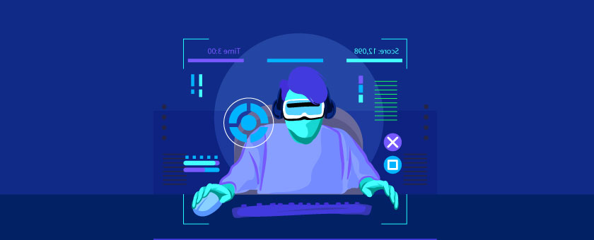
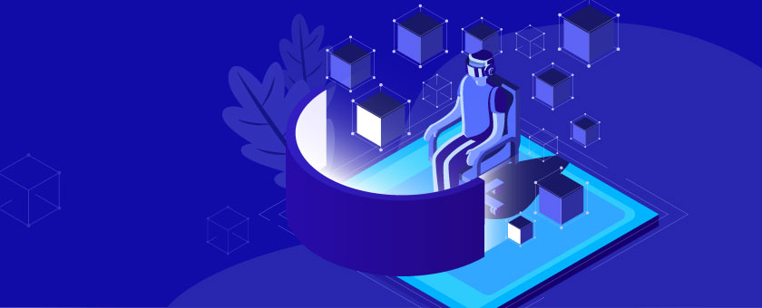
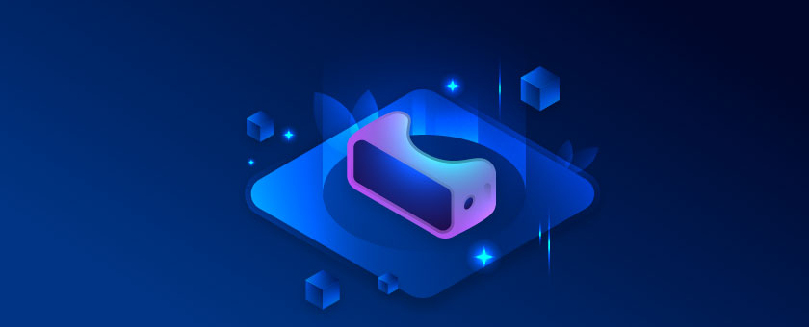
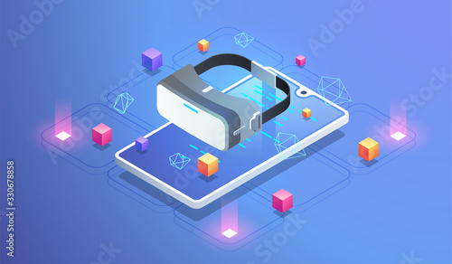
Types of VR technologies
Non-Immersive
Semi-Immersive
Fully-Immersive
Mixed Reality
Notes:
The industries that use VR in their daily job choose different types of immerse depending on what they use it for and which VR systems they really need. Despite that, most of the time, those types are collected under 4 categories.
The first category of VR systems is Non-immersive - While using this VR type, clients access the program using computer. There are simple devices as keyboard, mouse, and headphones are used so user don't interact with the virtual surrounding directly. Using Non-immersive VR games, players can enjoy the process not being taken away from their reality.
The next category that should be mentioned is Semi-immersive - As it is seen by its name, there, world is only partially virtual. In this type of Virtual Reality, also the experience is gotten from computer, but there are also might be used glasses or headsets. Users here, don't move actively during the process as in full immersive programs. only keyboard usage or slight head movements must be done.
Next category is Fully-immersive VR - This is the category that comes to mind when talking about Virtual Reality. In this type of system, users completely experience all the delights of total immersion in a virtual 3D environment. There users can hear sounds, explore surroundings and sometimes feel the textures. Scientists are even working on adding smelling technology to all the senses listed above. To experience full range of emotions, users are required to wear some devices, such as, helmets, gloves, headsets and glasses.
Last but not least category is Mixed Reality VR - This one obviously differs from other types of VR. If in previous Virtual Realities users would fall into the virtual world, here device brings digital objects to the real world. Mixed Reality overlays virtual items to the world we live in as augmented Reality does. Mixed Reality VR has great potential for a bright future in many areas. But also, It can be used in everyday life as well. For example, it will be entirely possible to try out a new makeup style just on your smartphone.

Slide 6

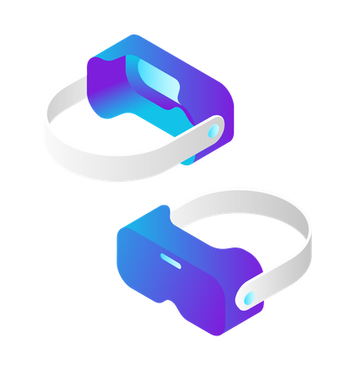
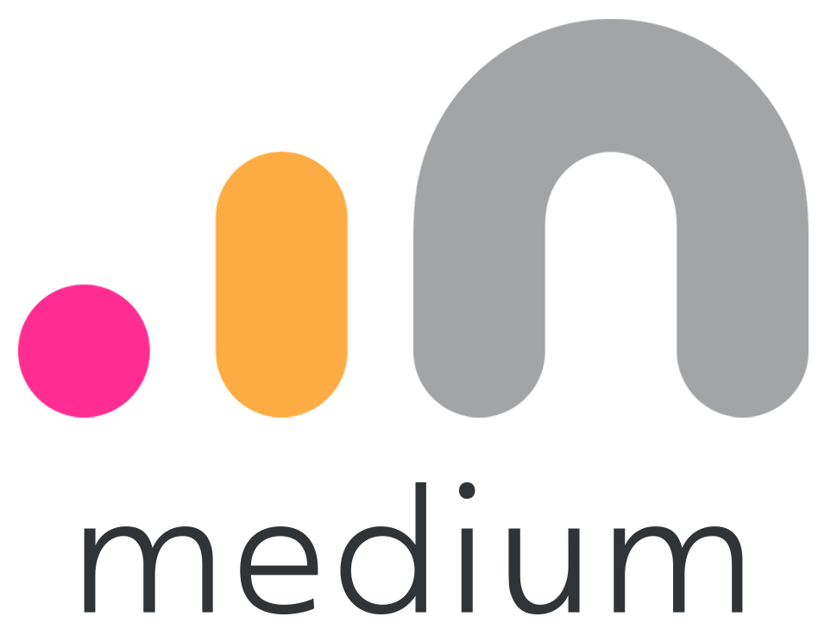
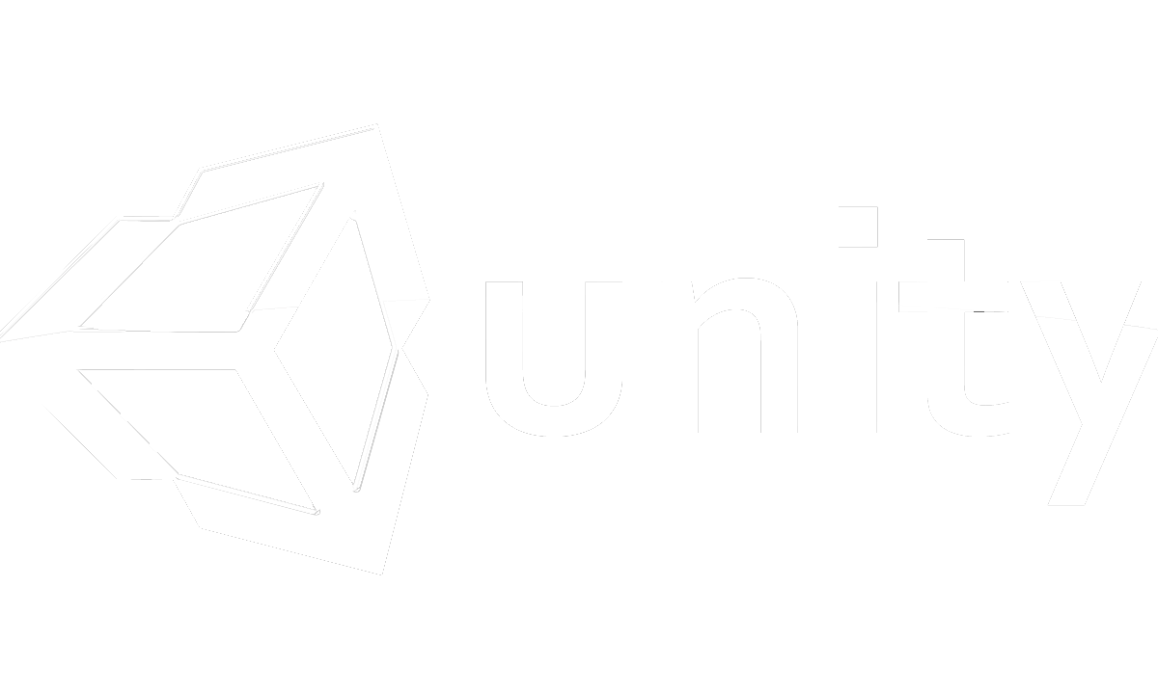


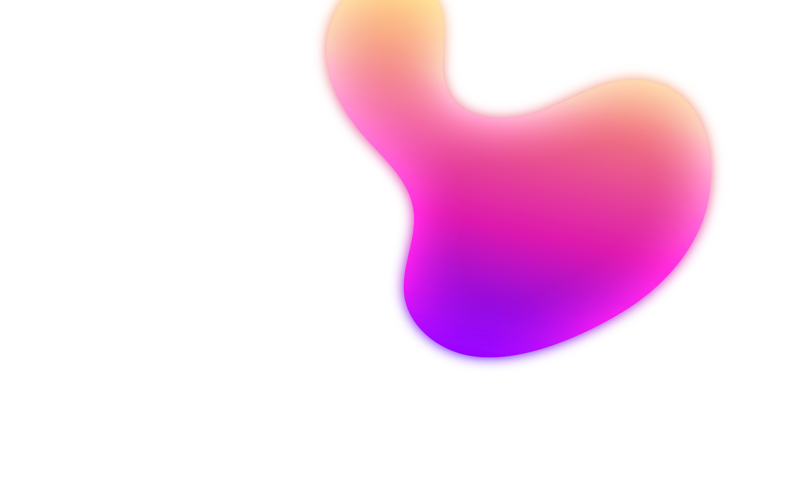
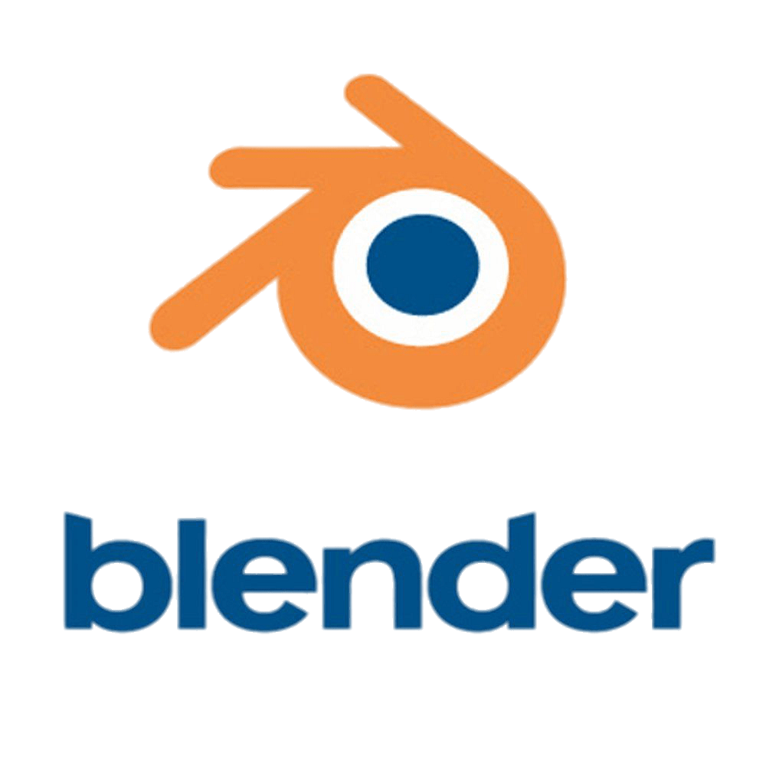
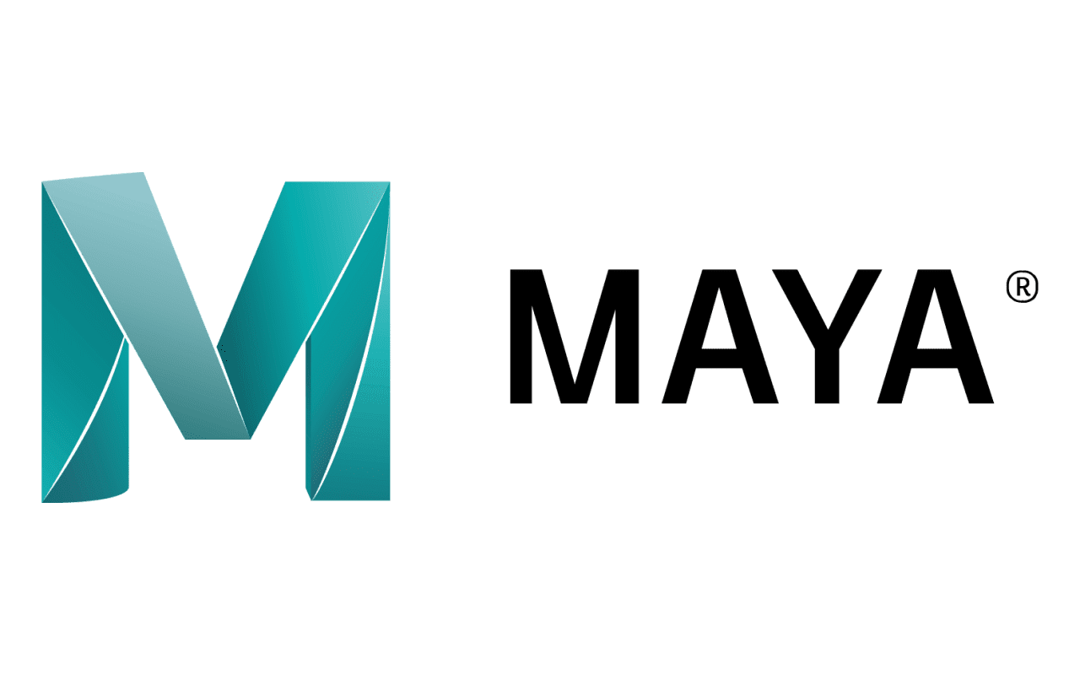
Software that can be used to create VR
Oculus Medium
UNITY
Amazon Sumerian
SketchUp Studio
Blender
MAYA
Notes:
Most of companies use the opportunity of VR to improve efficiency with great pleasure. They do it because of a few factors that VR can offer. However, in the usage of VR it is important to know which tools to choose. I tried to choose most popular tools that can be used for this purpose.
Unity - While Unity is considered the most popular game development tool, it is very versatile. There you can create a huge number of projects and VR is one of them. It is important to know that by using Unity, the user may become the owner of very useful tools such as CAD tools, an editor to make 3D VR assets in Unity, designing tools and etc. Unity can collaborate with many popular VR platforms. They can be Sony or Oculus or any other one. On the official website of this popular engine, new VR builders might get some help by accessing courses such as "Get started with Unity". There are actually a lot of courses that might be very useful for new creator. Unity has a great team that is always ready to help and give detailed information about their engine and how to use it. They also offer the FAQ page where everyone who wants might as their questions.[12]
Amazon Sumerian - This engine made by AWS, has a great advantage over other engines. Users are not required to have programming skills to be able to create something. Just like Unity, this engine works with lots of popular VR platforms. One of its benefits is that Amazon Sumerian works with IOS and Androids. One of the reasons of its popularity in different cases is its features. There are Sumerian editor, host, and Asset management. [12]
Maya - Is a tool that allows users create different types of graphics such as 3D animations or VFX software. This strong software is released by Autodesk and very popular among developers. There creators can make animations, edit the necessary graphics in different ways, including adding 3D effects and modeling.[12]
Oculus Medium - names of platforms that this software provides (Oculus Quest, Oculus go, and others) have been listed above several times, so it is not hard to say that it is a very well-known system. Oculus Medium uses development software that is known for its power and named Medium, which lets create different 3D assets. There creators can edit, change and work on their VR models however they want to.
SketchUp Studio tool - Is actually useful platform that is known because its strength. Also, there is a peculiarity that differentiates this tool from many others: it is mainly concentrated on the architecture and building industry. This platform is very useful for companies in these industries that want to make VR applications for their projects.
Blender - This is one of the few open-source services that can offer a big number of features in creating 3D objects. The software was released by Blender Foundations that is considered as a public benefits organization. Blender is very useful free application that offers numerous functions such as creating a 3D pipeline that can present modeling, animating, rigging, motion tracking, and rendering. The software also provides video editions and the creation or VR games. Blender can be easily downloaded to any operation system.[12]

Slide 7

CHAPTER 3
Creation of Virtual Museum
Creation of Virtual Museum

Slide 8

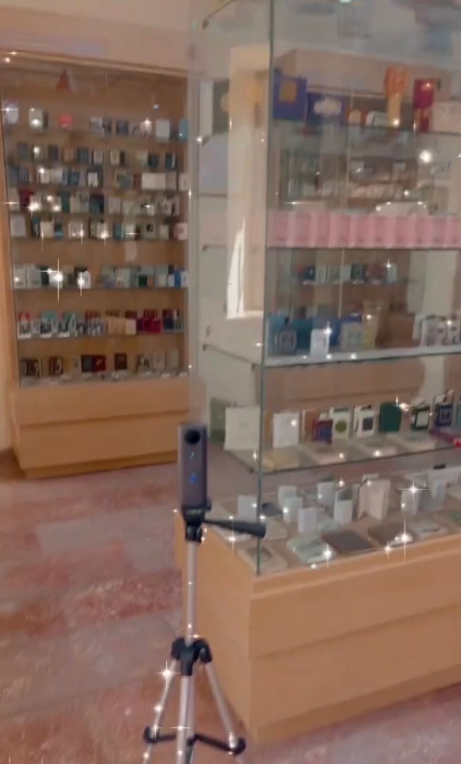
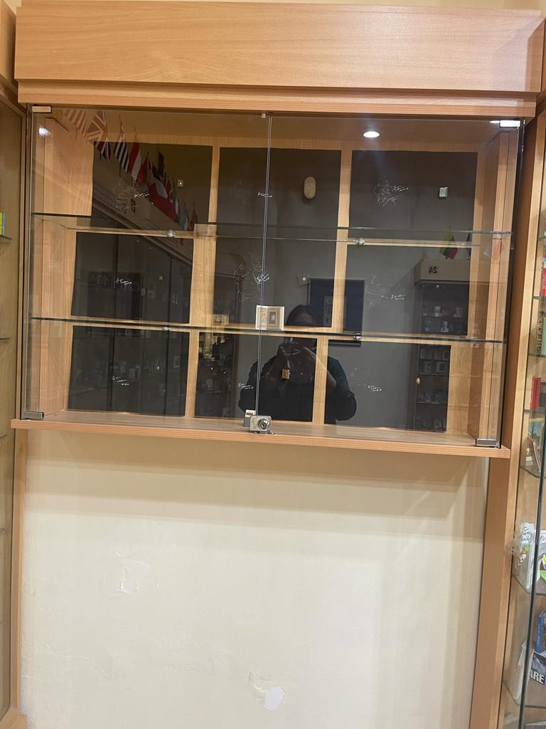
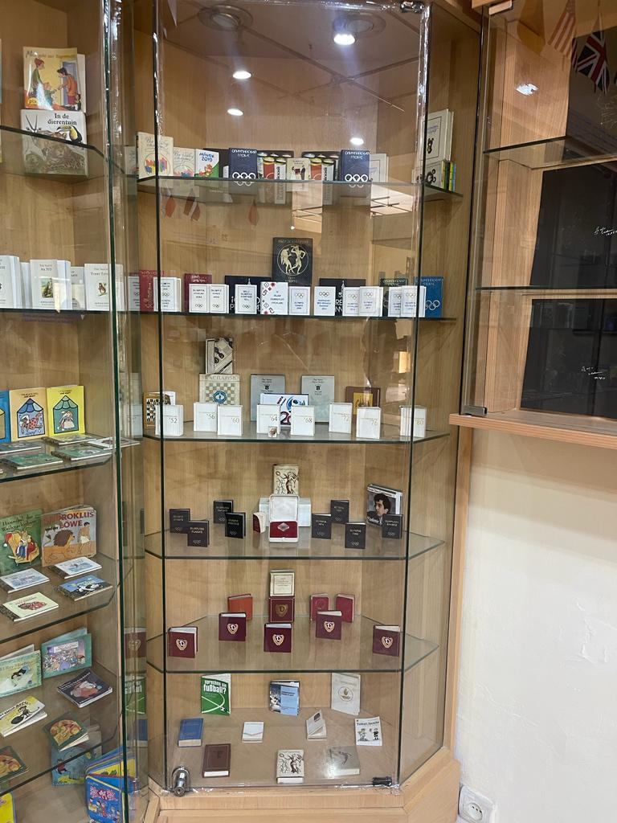
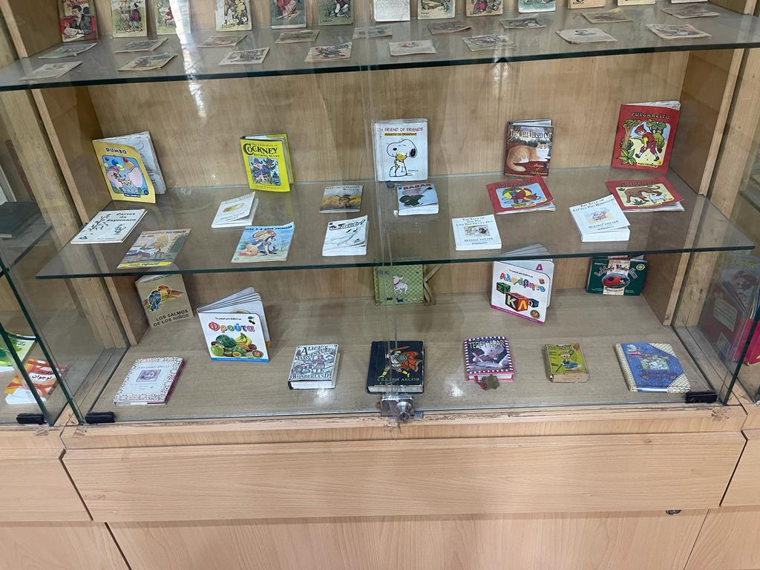

Slide 9
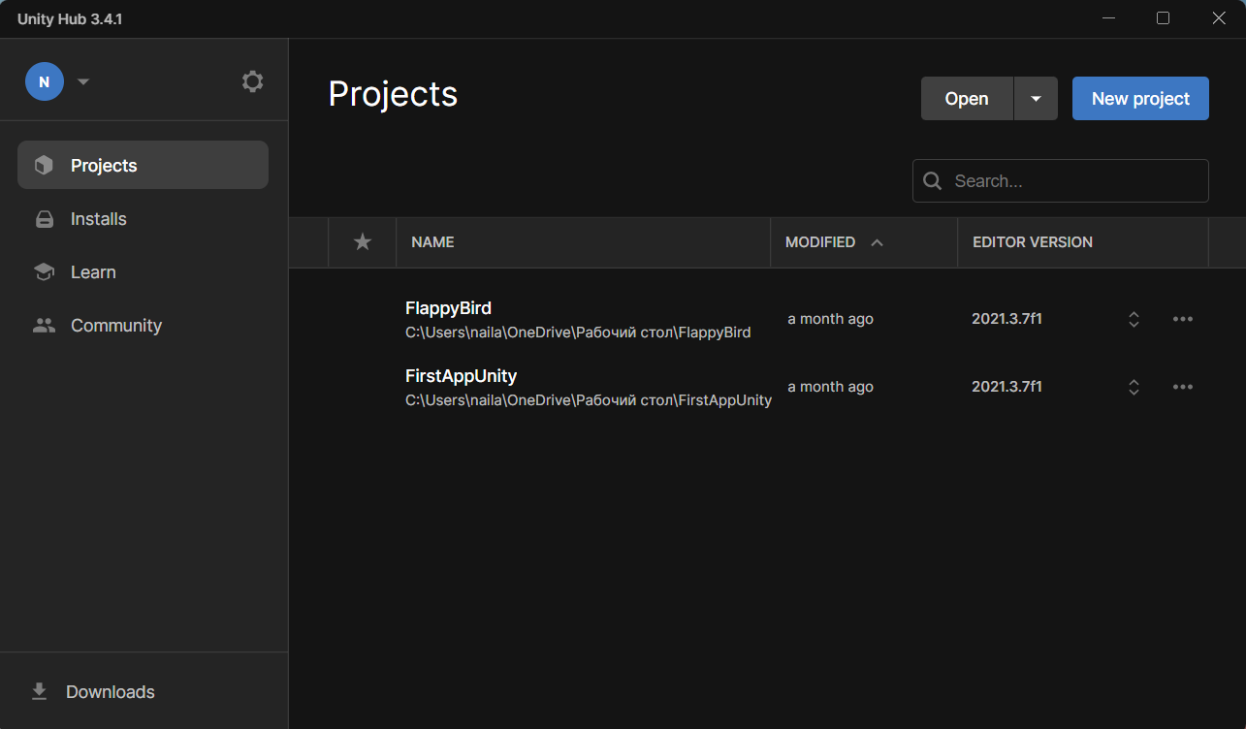
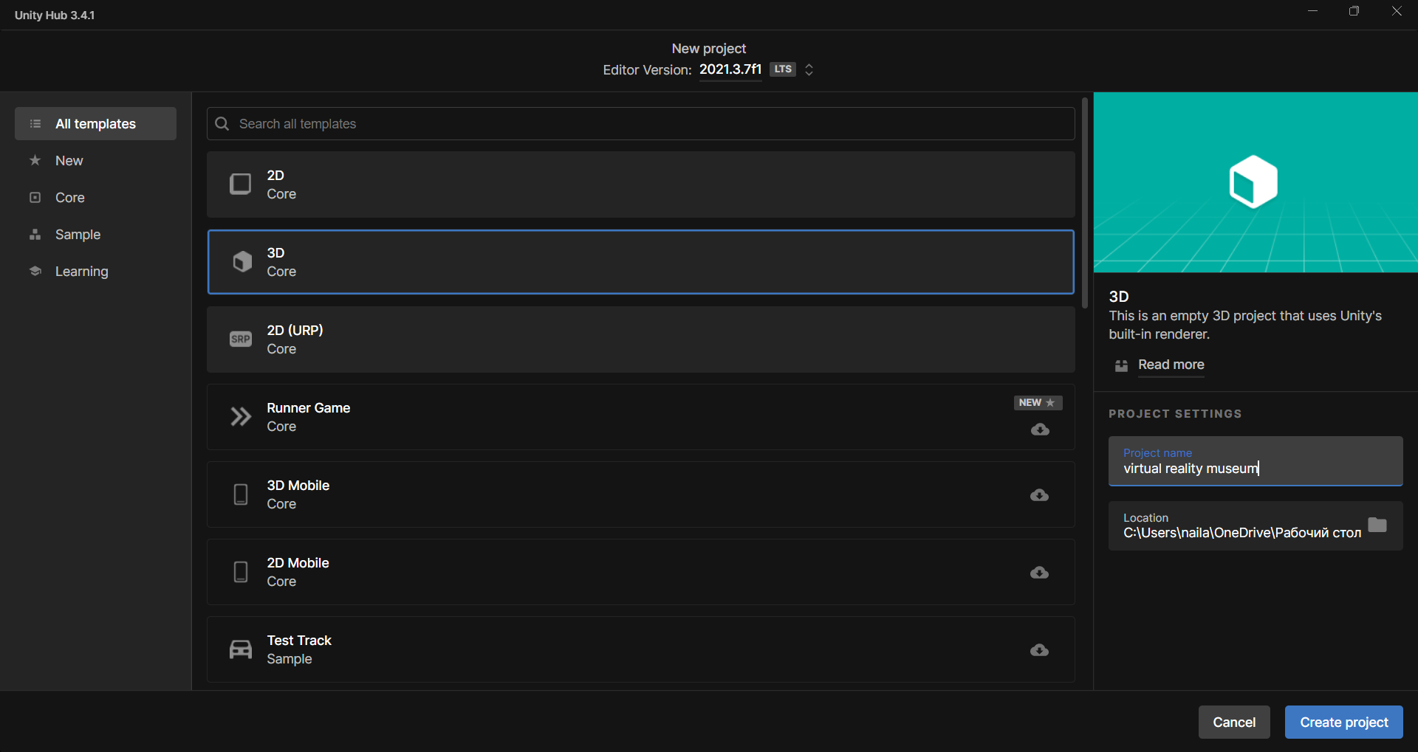

Slide 10
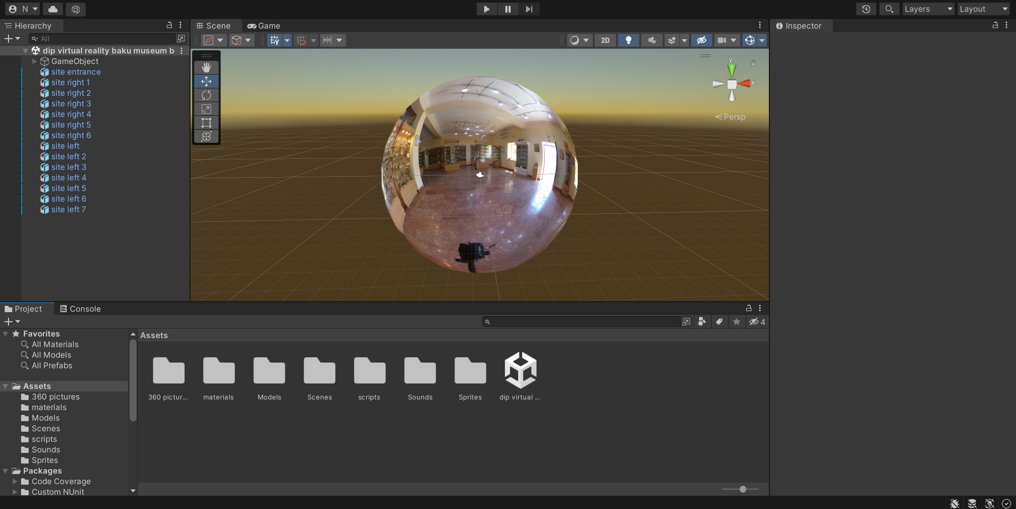
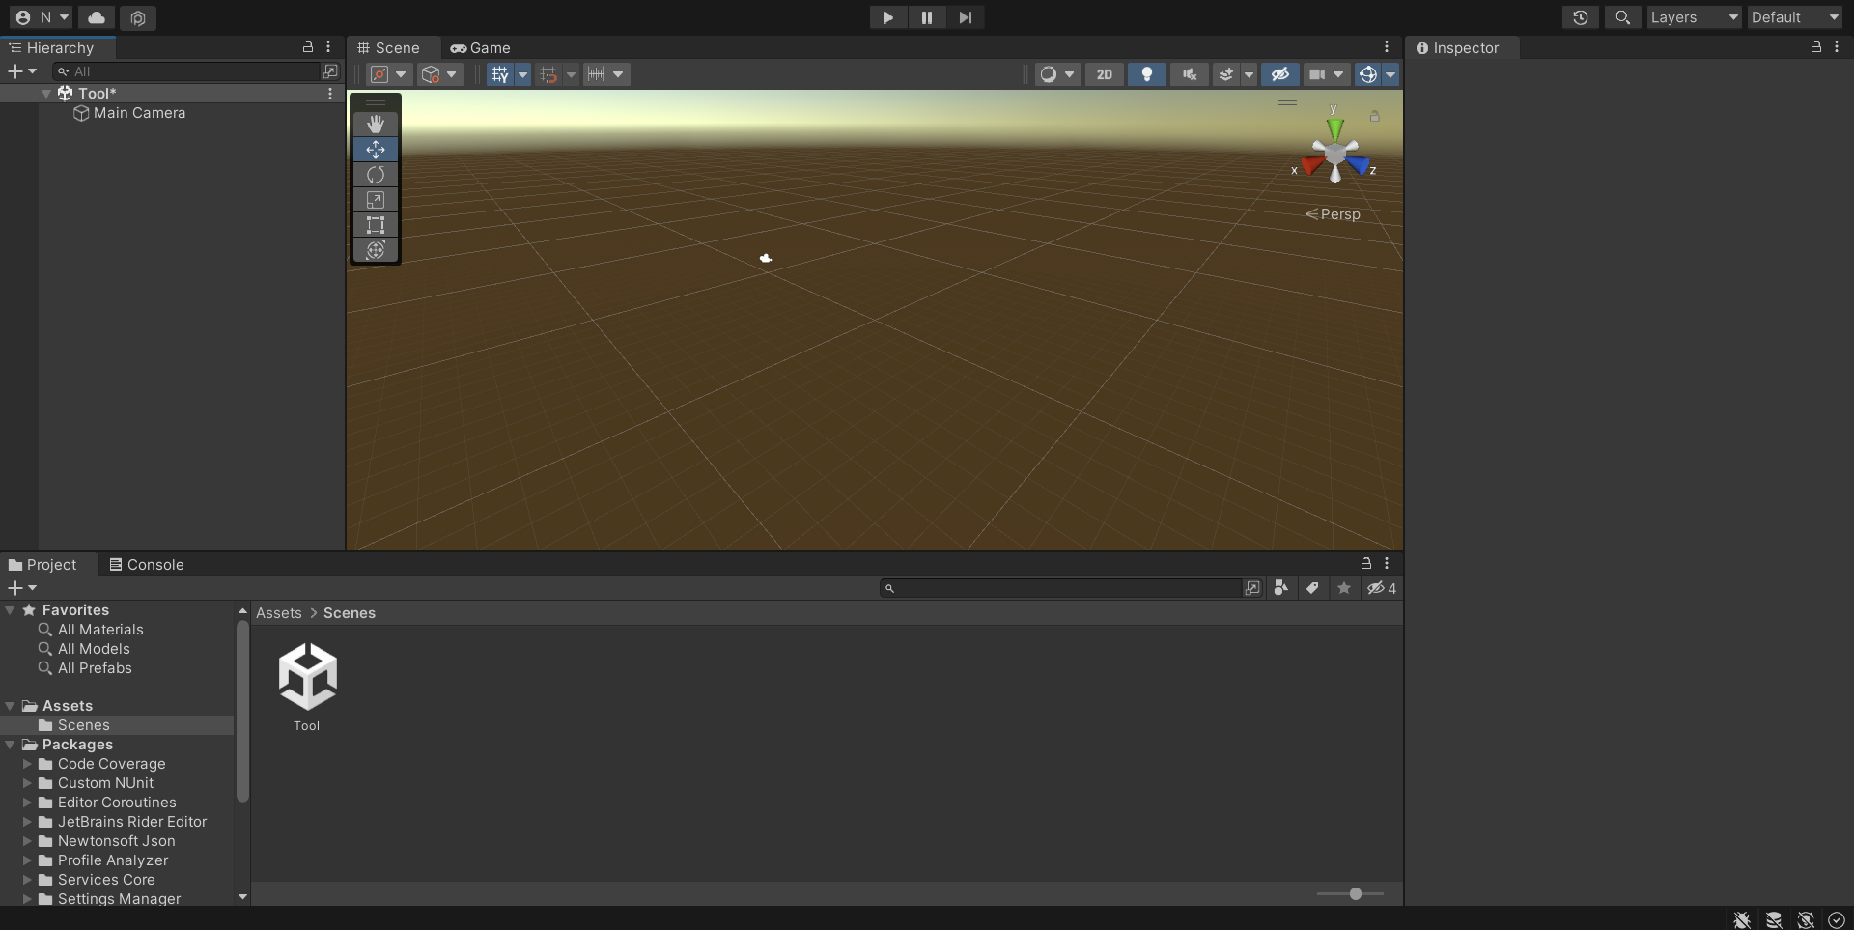
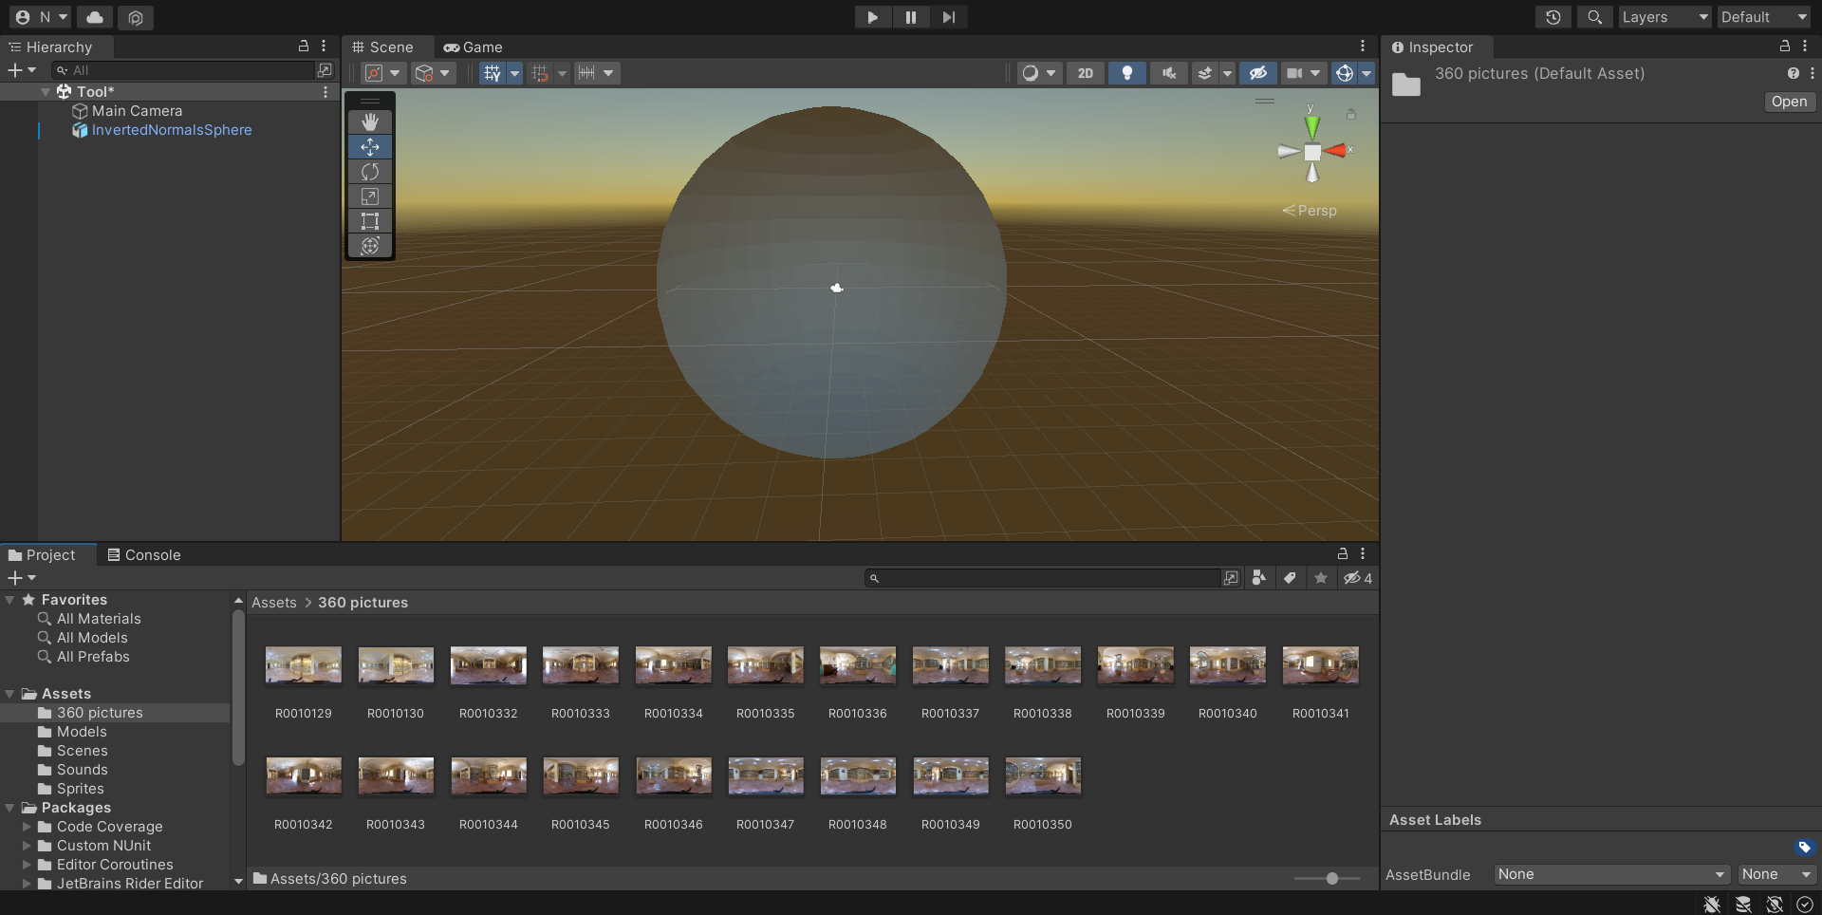
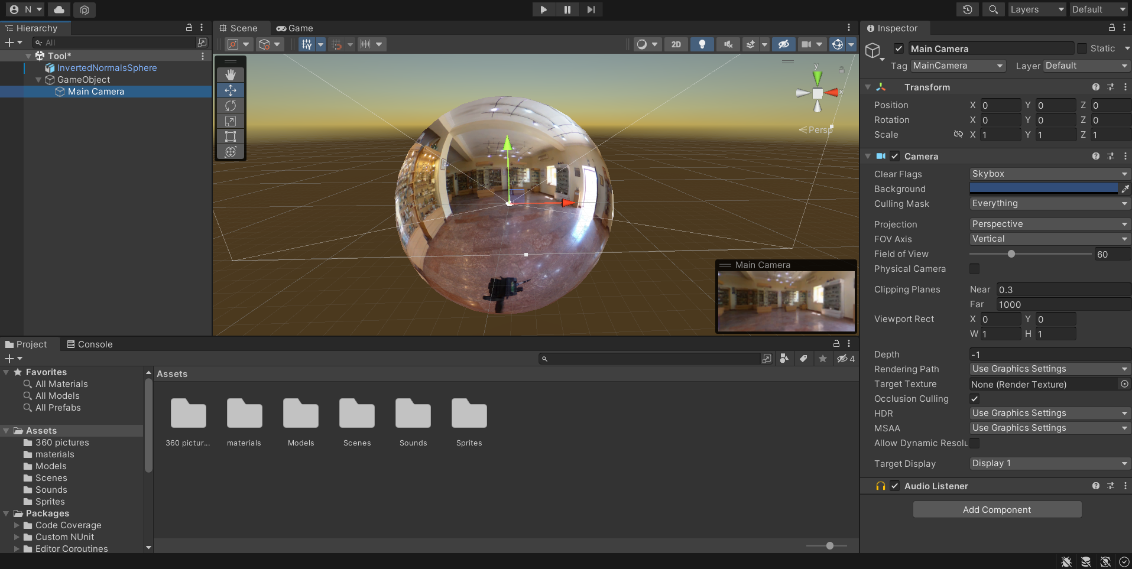

Slide 11
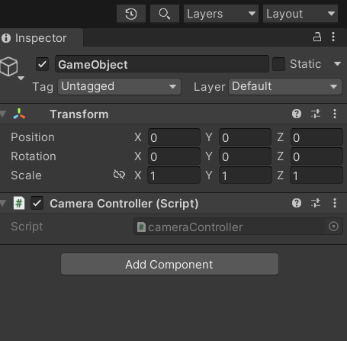
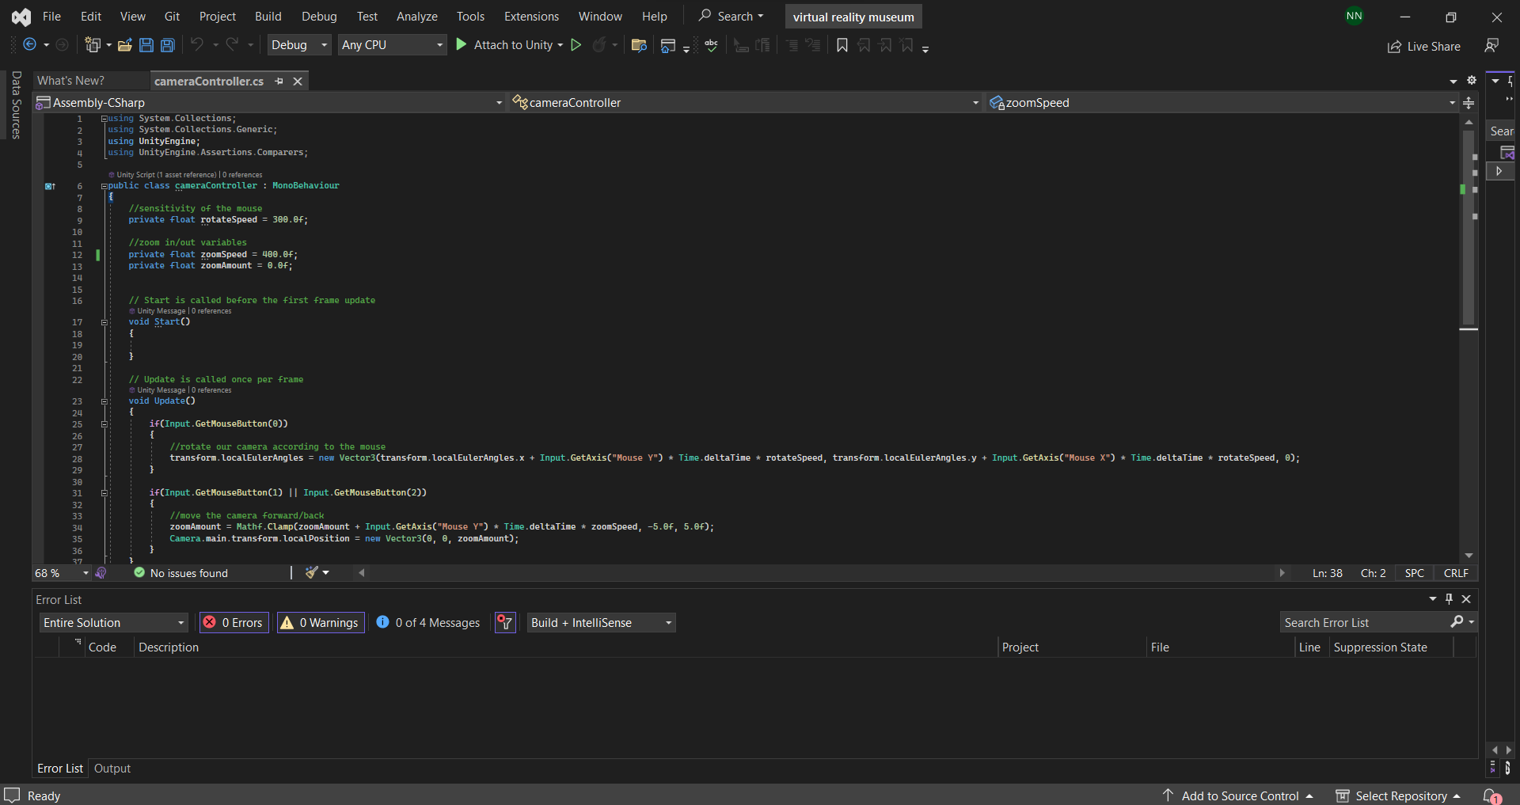

Slide 12
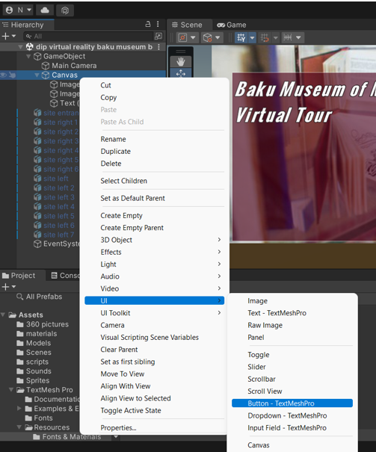
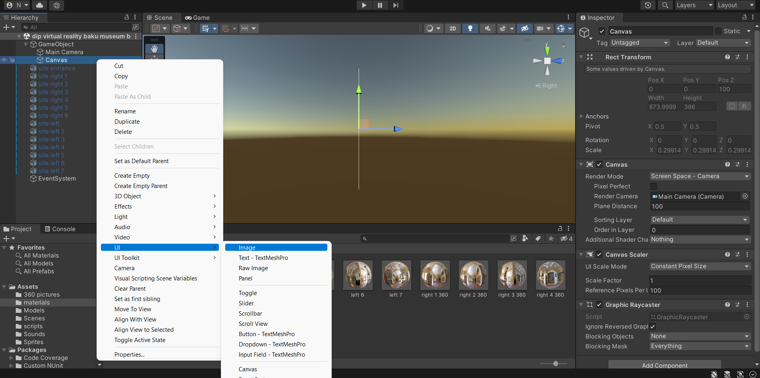

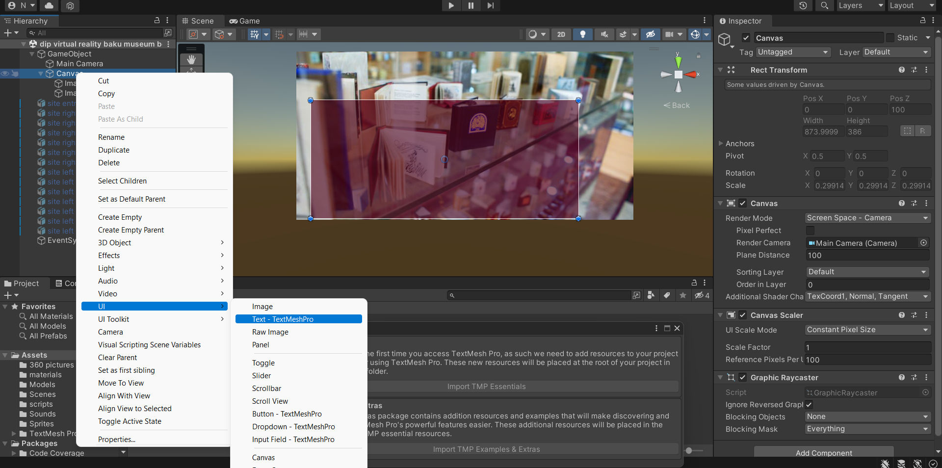

Slide 13
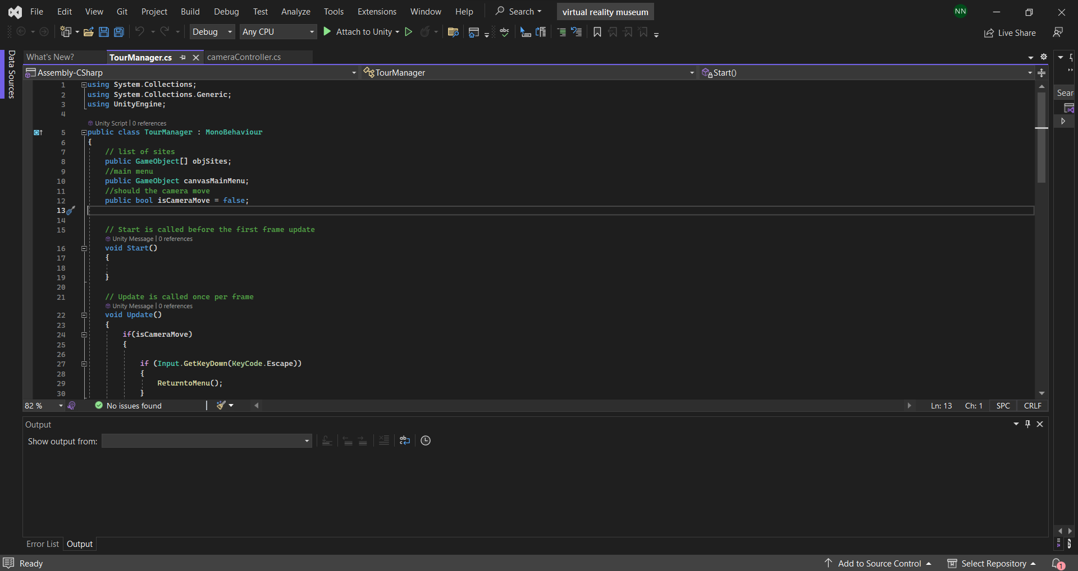
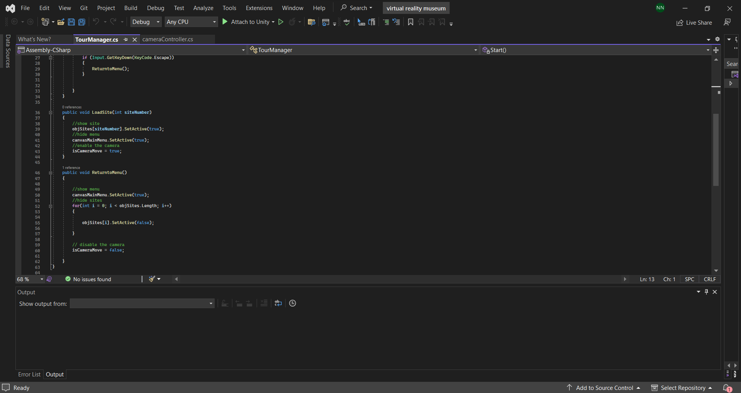
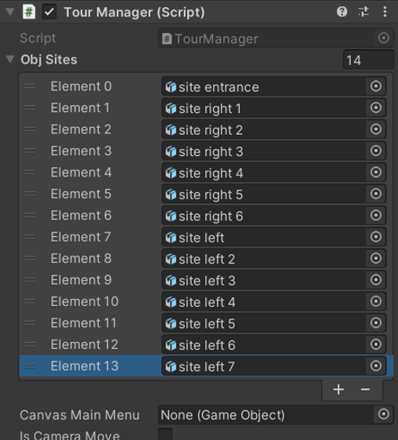

Slide 14
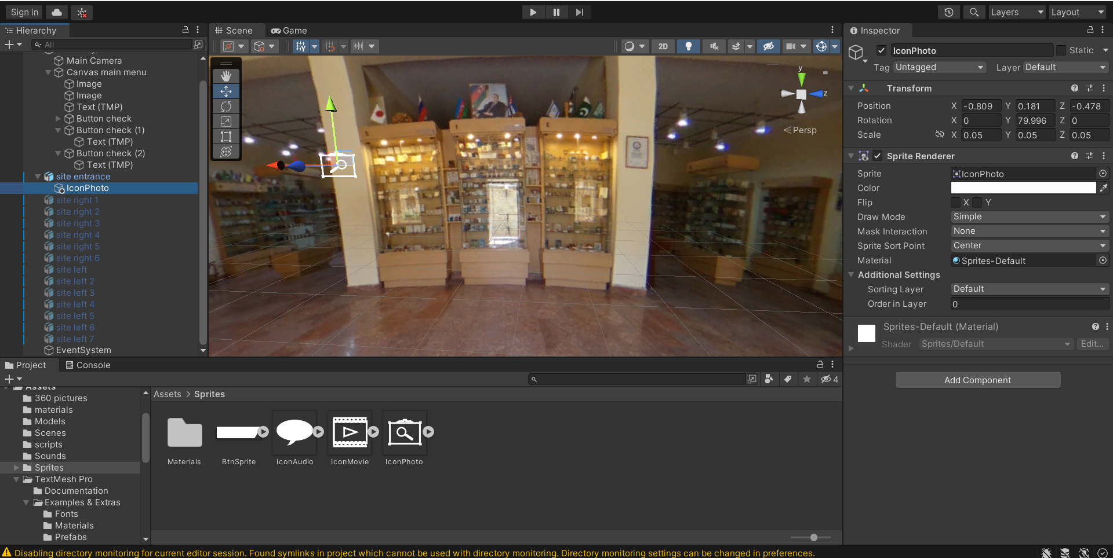
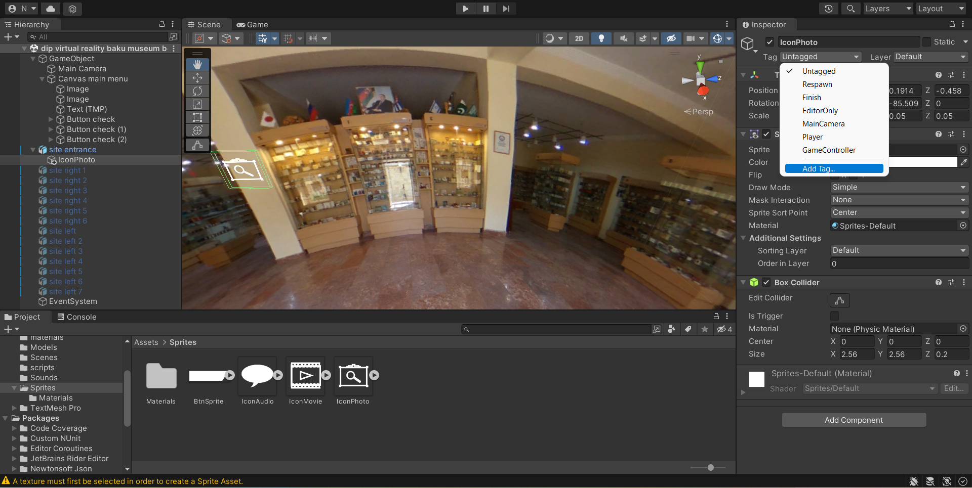
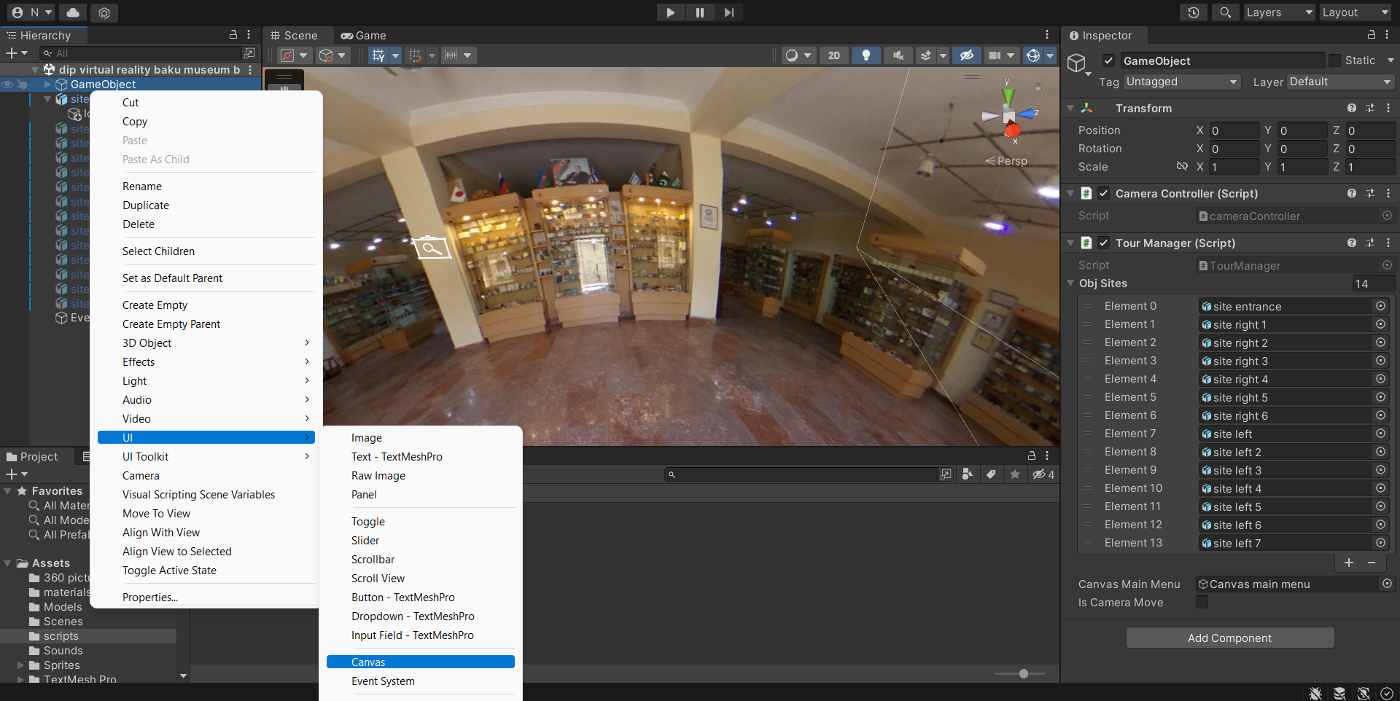
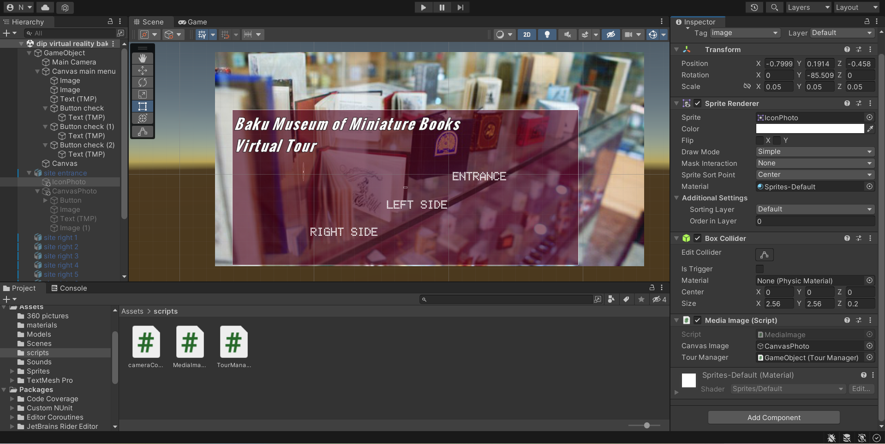
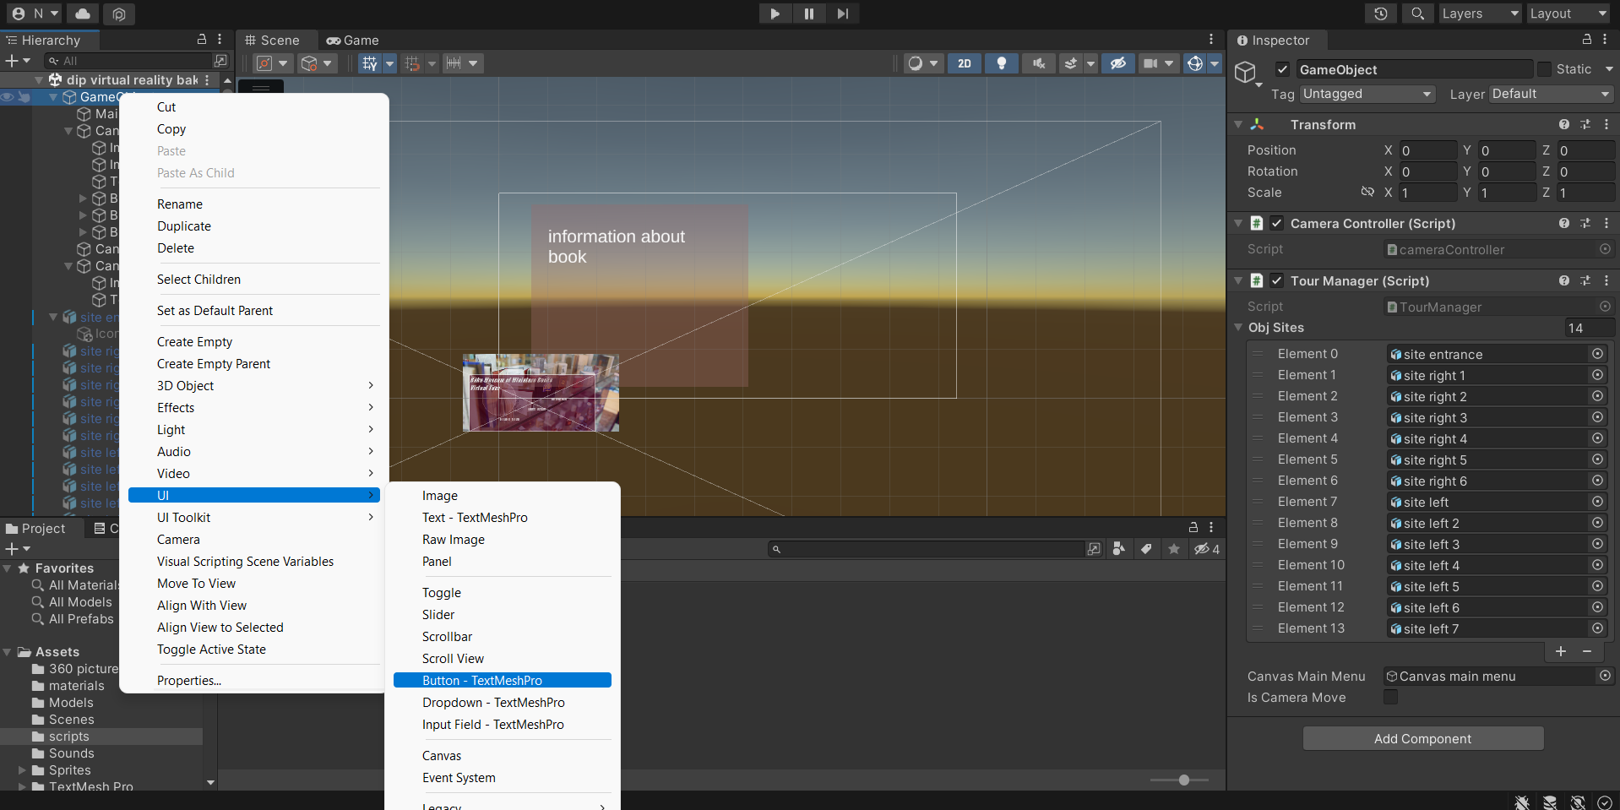
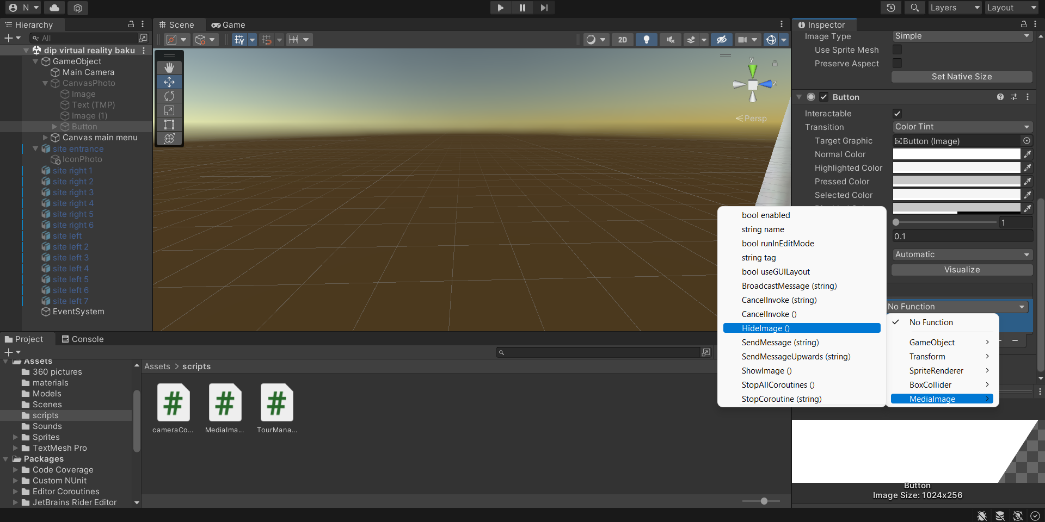
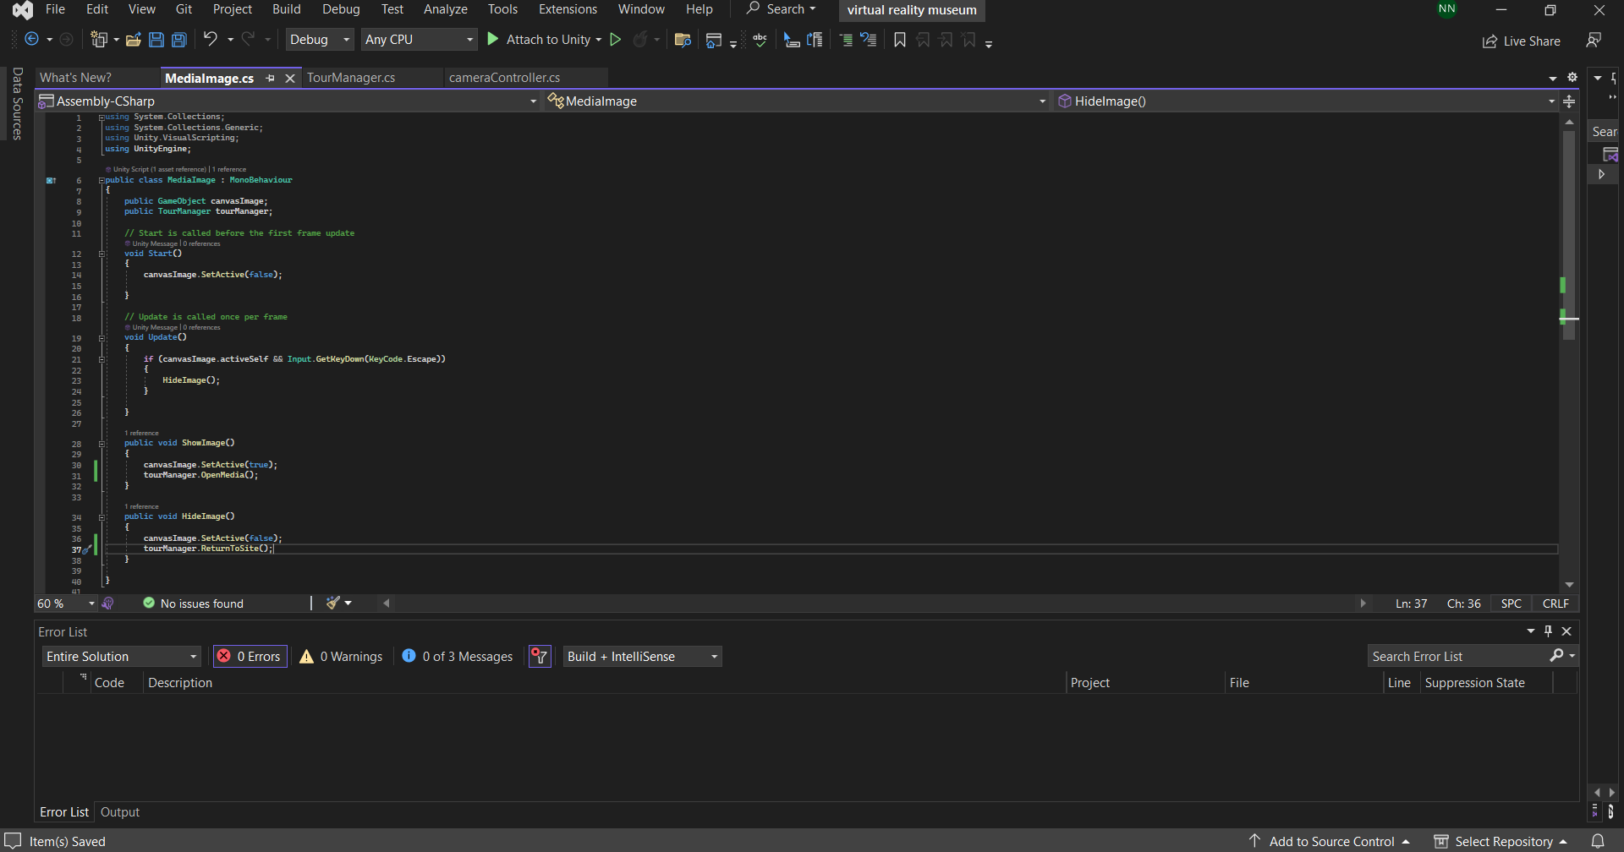

Slide 15
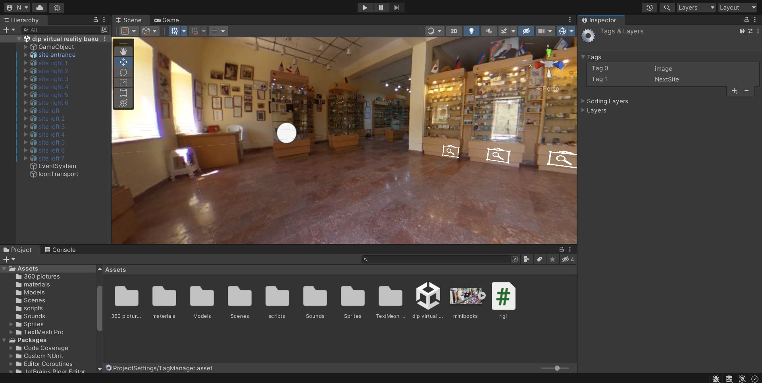
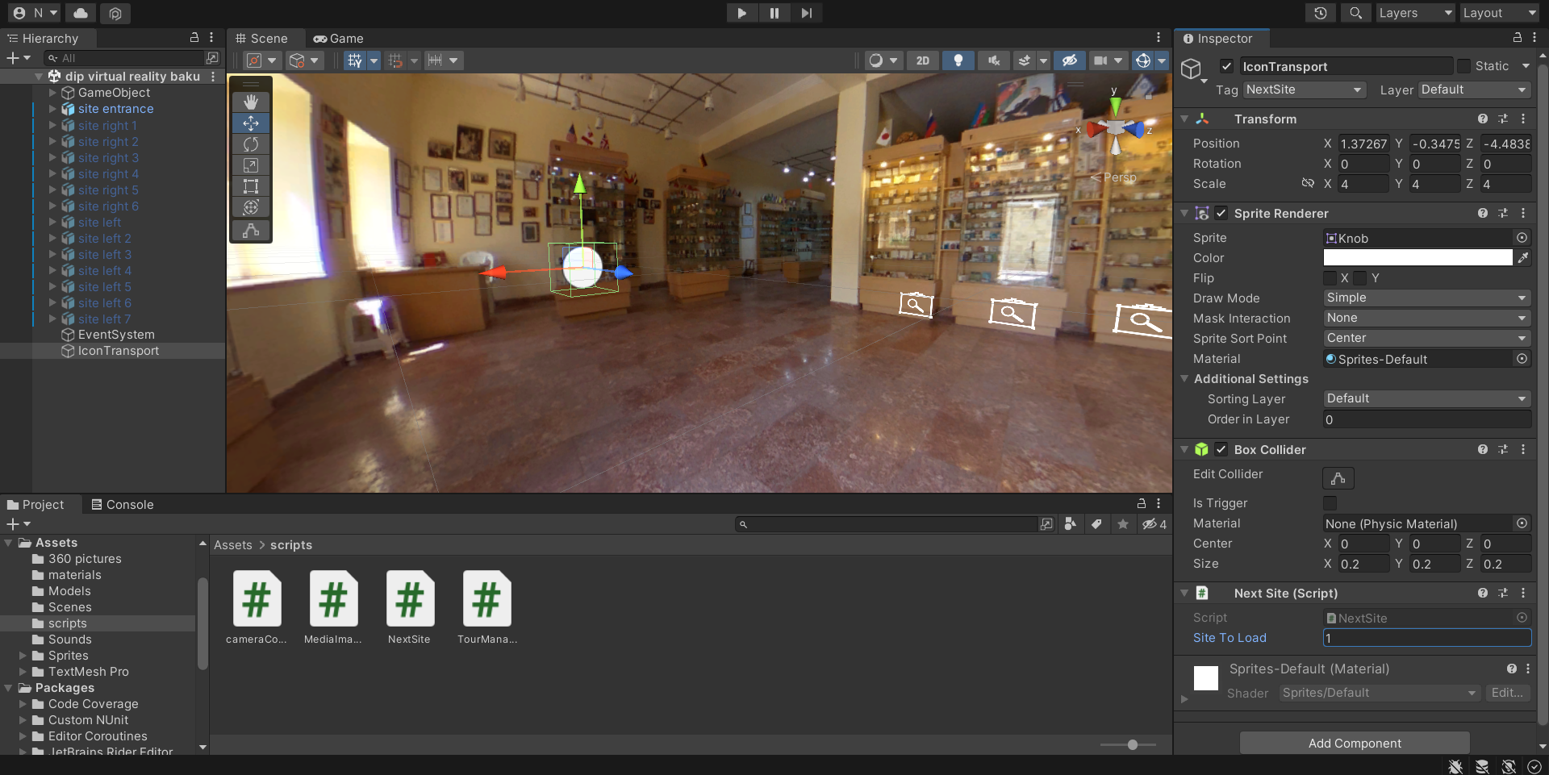
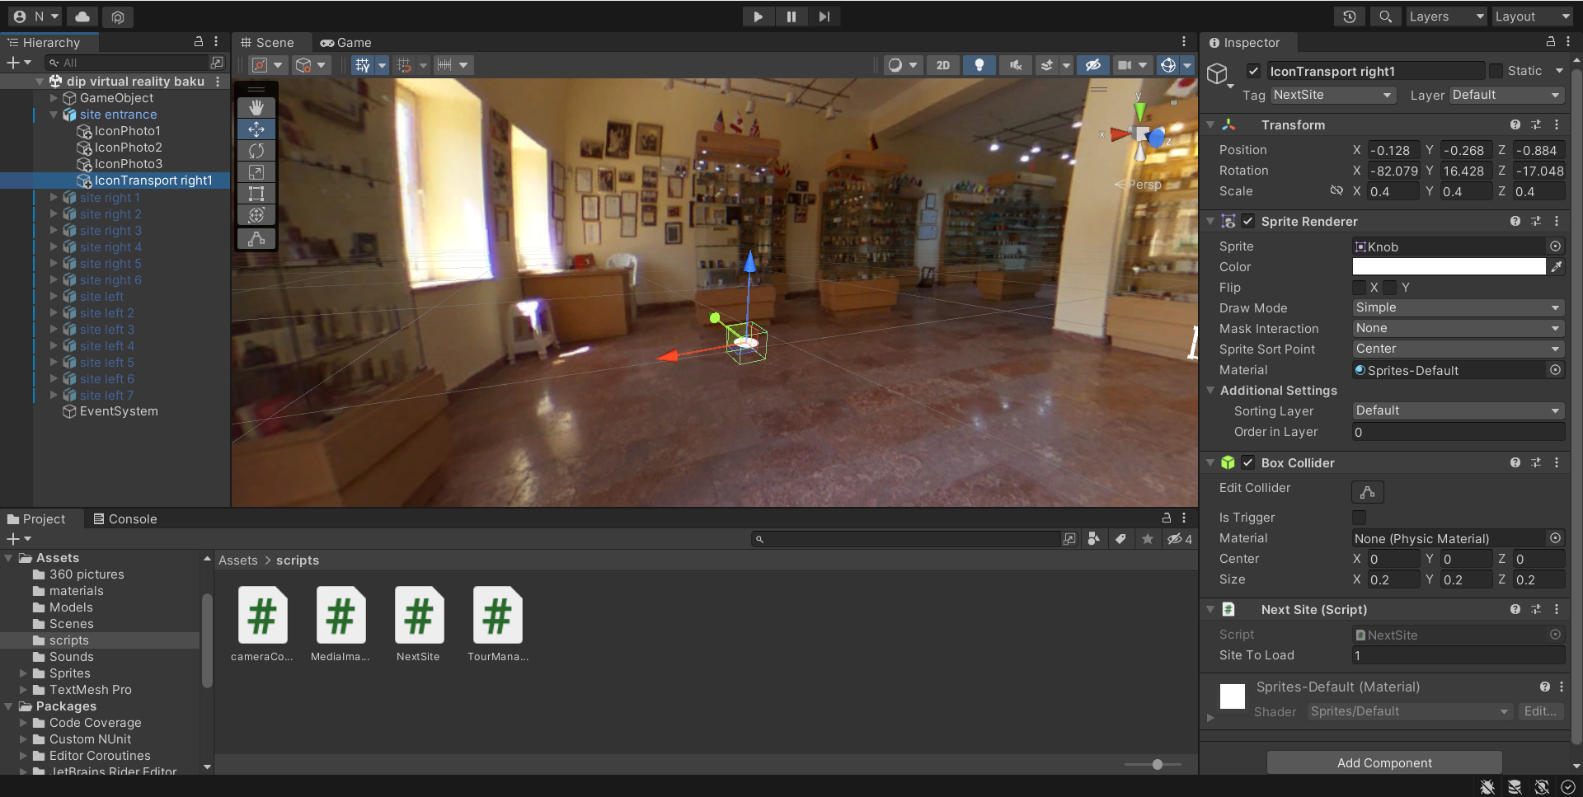
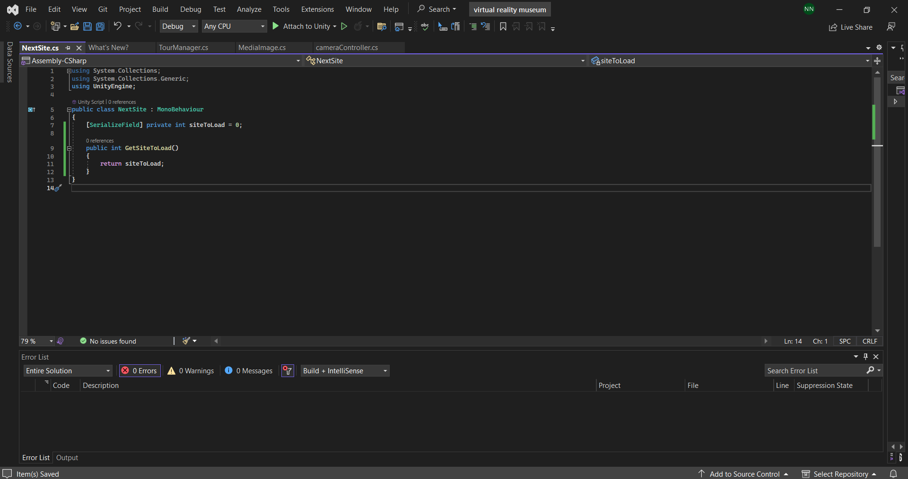

Slide 16
Resources
Jon Peddie- Augmented Reality - Where We Will All Live, 2017,323
https://www.techtarget.com/whatis/definition/virtual-reality
https://www.britannica.com/technology/virtual-reality
Jay David Bolter, Maria Engberg, Blair MacIntyre - Reality Media - Augmented and Virtual Reality, 2021, 248
Mario Gutierrez, Mario Arturo Gutiérrez Alonso, F. Vexo, Daniel Thalmann - Stepping Into Virtual Reality, 2008, 214
Samuel Greengard - Virtual Reality, 2019, 264
https://roundtablelearning.com/how-to-create-original-vr-content-everything-you-need-to-know/
https://filmora.wondershare.com/virtual-reality/how-does-vr-work.html
https://www.xrtoday.com/virtual-reality/how-does-virtual-reality-work/
https://www.softwaretestinghelp.com/what-is-virtual-reality/
Josh Gregory - Virtual Reality, 2017, 32
https://www.g2.com/categories/virtual-reality
https://www.inverse.com/input/style/nike-archival-styles-augmented-reality-webar
https://www.devteam.space/blog/10-great-tools-for-vr-development/
https://www.loreal.com/en/press-release/research-and-innovation/loreal-and-facebook-bring-virtual-tryons-to-instagram-shopping-with-modiface/
Dragan Cvetković- Virtual Reality and Its Application in Education, 2021,100
Cathleen Small - Using VR in Gaming, 2019, 80
Cathleen Small - Using VR in Medicine, 2019,80
Hazim Rekab - Online Shopping Experience in Virtual Reality, 2018, 54
Carola Epple - From Hype to Value. Virtual Reality Tools in the Tourism Industry and Their Influence on Booking Behaviour, 2018, 94

Slide 17
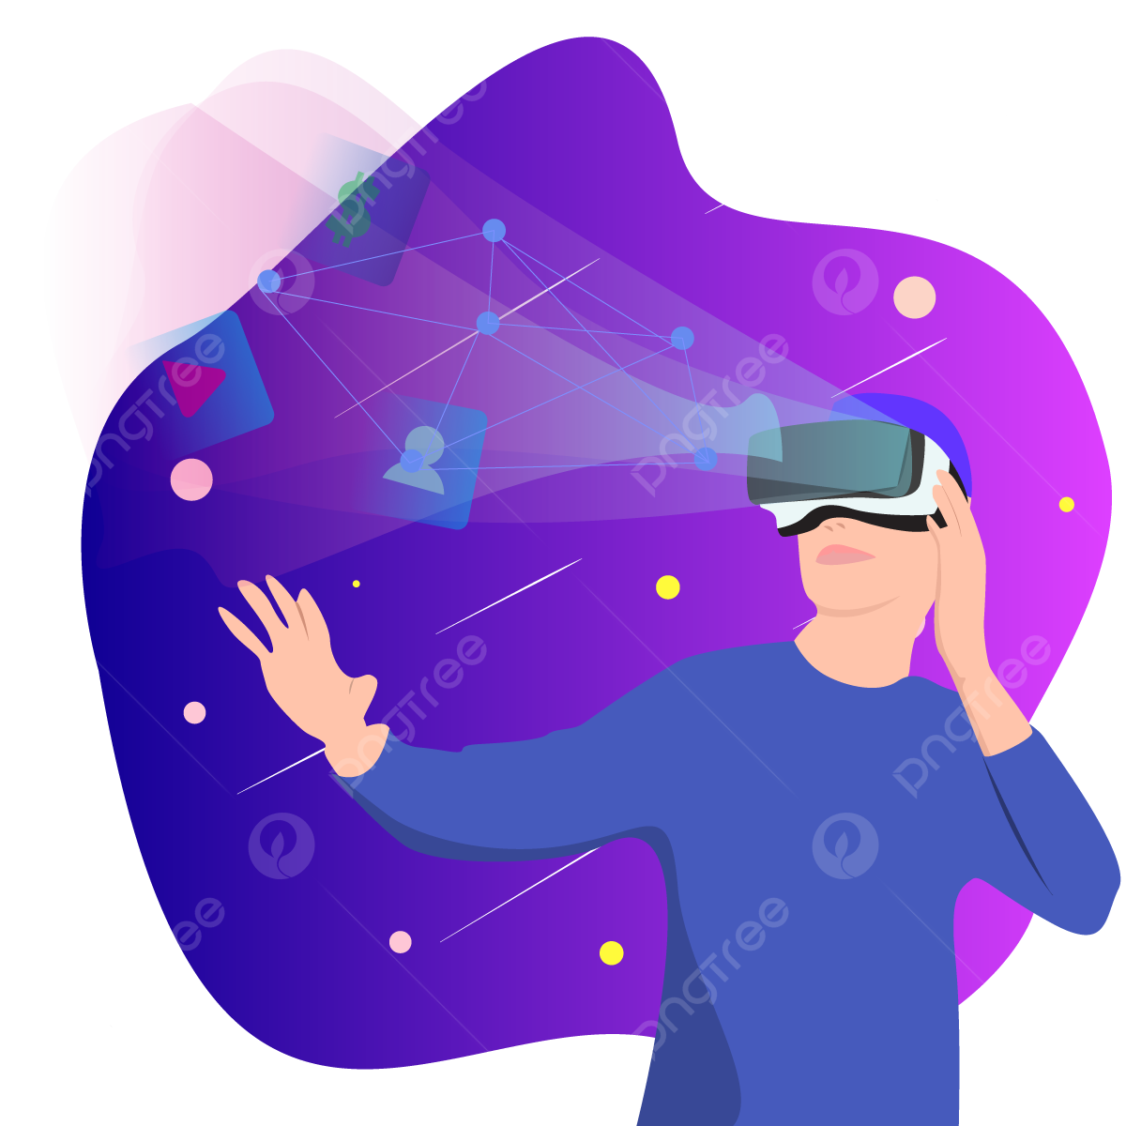
Thank you for your attention

